Slide 1

COMP1516
Lesson 7: Sets, Dictionaries

Slide 2
Learning Outcomes: Lesson 7
Sets
Dictionaries
Nested Dictionaries

Slide 3
Sets
The four container types in python are tuples, lists, sets, and dictionaries
A set is a container object that stores a collection of data
All elements are unique…no duplicates
Elements in a set are not stored in any particular order
Elements in a set can be of different data types

Slide 4

Sets
A set can be created using curly brackets {}

Slide 5


Sets
A set can also be created using the built-in set() function
Strings are treated as separate items unless given as a list or tuple

Slide 6



Sets
Items cannot be accessed by referring to an index
Instead, we will loop through the set, or ask “if” the set contains a certain item
Use the in keyword

Slide 7

Sets
Once a set is created, its items cannot be changed, but entire items can be added or removed
Add a single item with the add() method
Add multiple items with the update() method

Slide 8



Sets
Get the number of items in a set with the len() function
Remove an item with the remove() method
Remove an item with the discard() method
*if the item does not exist, remove()
will raise an error
*if the item does not exist, discard()
will NOT raise an error

Slide 9


Sets
The clear() method empties the set
The del keyword will delete the set completely

Slide 10

Sets
The union() method returns a new set that contains all items from the two sets being unioned
Note: this can also be accomplished with the update() method

Slide 11
Dictionaries
A dictionary (sometimes called a map) is an object that stores an unordered collection of data
Each element has two parts: a key and a value
A list element has an index A dictionary value has a key
A key is a meaningful index
Each key is associated with one value, much like each word in the English Language dictionary (“key”) is associated with a definition (“value”). Use the key to access its value.
Elements are commonly referred to as items, or as key-value pairs
To retrieve a specific value from a dictionary, you use the key that is associated with that value

Slide 12
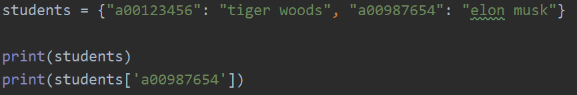

Dictionaries
You can create a dictionary using burly braces {} and colons to separate the {key: value} pairs
The keys ‘a00123456’, and ‘a00987654’, have the values ‘tiger woods’, and ‘elon musk’ associated with them respectively
dictionary_name = { “key_name” : “value”, “key_2_name” : “value 2”, “key_3_name”: “value 3”}

Slide 13
Syntax of the Four Container Types
Tuple ( value1, value2 )
List [ value3, value4 ]
Set { value5, value6 }
Dictionary { key7: value7, key8: value8 }

Slide 14

Dictionaries
You can also use the built-in function dict() using keyword arguments to specify key-value pairs
Or by specifying a list of tuple-pairs

Slide 15
Dictionaries
Access values by using square brackets: dictionary_name[key]
…or by using the get() method
Square brackets are also used for adding or modifying values
If the key exists, the value is modified (NO DUPLICATE KEYS ARE POSSIBLE)
If the key does not exist, the new key-value pair is added to the dictionary

Slide 16
Dictionaries
Delete an item with the del keyword and the item’s key
Remove all items from a dictionary using the clear() method
Merge dictionaries together using the update() method
Existing entries are overwritten if the same key exists in the dictionary (more_cars) more than once

Slide 17
Dictionaries
Remove and return the key value from the dictionary using the pop() method
If a value does not exist, the specified default is returned
Use the in keyword to test for existence of a key in cars
The len() function is used to determine the number of items in a dictionary

Slide 18
Dictionaries
numbers = {1: "one", 2: "two", 17: "seventeen", 5: "five", 300: "three hundred", 0: "zero"}
numbers[8] = "eight"
print(numbers)
print(numbers[17])
if 300 in numbers: # checks the keys by default
print(numbers[300])
else:
print("no 300")
if 300 in numbers.keys(): # checks the keys
print(numbers[300])
else:
print("no 300")
if "seventeen" in numbers.values(): # directly checks the values
print("found seventeen")
else:
print("no seventeen")

Slide 19
Dictionaries: Iterating
students = {"a00123456": "tiger woods", "a00987654": "elon musk", "a00555555": "bill gates"}
students["a00111111"] = 'steve jobs’
# student = students.pop("a00987654", "student not found") # retrieves and removes
# print("student is " + student)
print(students)
print(students['a00123456'])
for key in students:
print("the key is %s..." % key)
for key in students:
print("the key is %s and the value is %s!!" % (key, students[key]))
for value in students.values():
print("the student is " + value)
for key, value in students.items():
print("key is %s and value is %s :)" % (key, value))
for student_number, student_name in students.items():
print("key is %s and value is %s :)" % (student_number, student_name))

Slide 20
Dictionaries: Nested
canada = {"bc": "british columbia", "ab": "alberta", "sk": "saskatchewan"}
united_states = {"or": "oregon", "ca": "california", "az": "arizona", "as": "alaska"}
china = {"ni": "ningxia", "ga": "gansu"}
countries = {"ca": canada, "us": united_states, "ch": china}
for country in countries: # runs 3 times: country is the key: ca, then us, then ch
print("The country is %s!!!" % country)
for province_code, province_name in countries[country].items():
print("%s is the code for %s..." % (province_code, province_name))

Slide 21
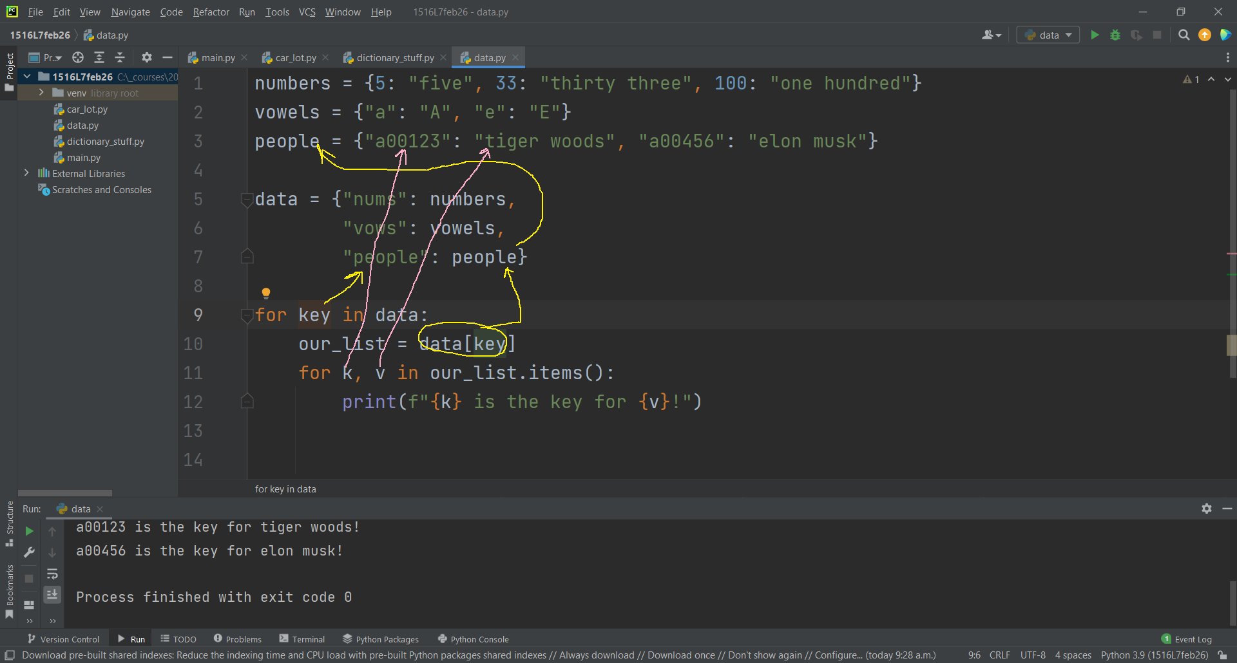

Slide 22
Dictionaries: Nested
golfers = {"tw": "tiger woods", "pm": "phil mickelson"}
singers = {"kp": "katy perry", "tr": "trent reznor", "ny": "neil young"}
athletes = {"wg": "wayne gretzky", "mt": "mike tyson"}
people = {"golf": golfers, "sports": athletes, "music": singers}
for job in people:
print("people who do " + job + ":")
for initials in people[job]:
print("The initials " + initials + " stand for " + people[job][initials])

Slide 23
Dictionaries: Nested
hockey_players = {"wg": "wayne gretzky", "sc": "sydney crosby", "pb": "pavel bure", "tl": "trevor linden"}
golfers = {"tw": "tiger woods", "jn": "jack nicklaus"}
singers = {"ny": "neil young"}
fighters = {"mt": "mike tyson", "cn": "chuck norris", "bl": "bruce lee"}
people = {"hockey": hockey_players, "golf": golfers, "music": singers, "fighting": fighters}
print(len(people))
for key in people:
print(key)
these_people_dict = people[key]
for initials in these_people_dict:
print("The initials %s stand for name %s who is into %s!" % (initials, these_people_dict[initials], key))

